Slide 1
Gold Price Prediction Using Deep Learning
Dataset: https://www.kaggle.com/anushaharikumar/predicting-gold-price-using-ml-techniques/data
The historical data of Gold ETF fetched from Yahoo finance.
The data is collected from 2011 to 2018.

Slide 2
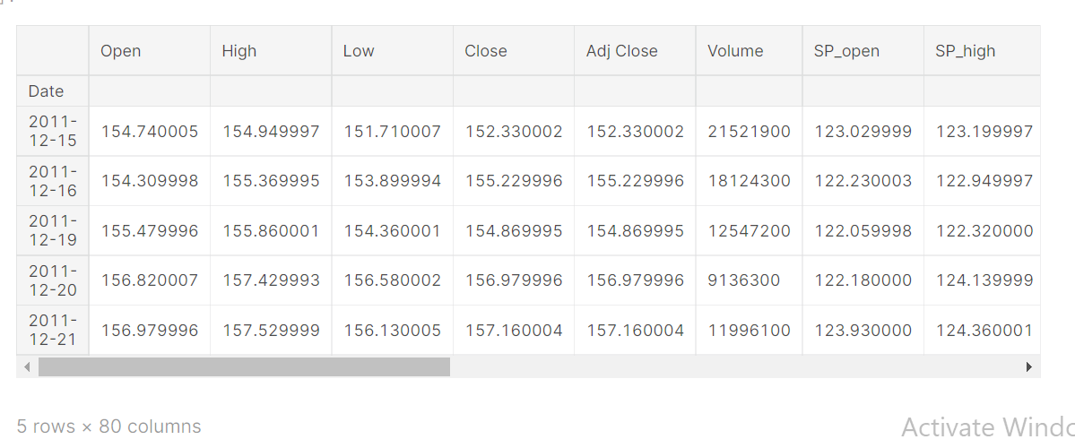
Given features
In the dataset there are 80 features already given.
The price of gold changes with these features. The are as follows:

Slide 3
S.no | Feature | Description
1 | Open | This feature is about the opening price of gold on a given date, i.e. at 12:00am.
2 | High | The highest price of the gold recorded on a given date.
3 | Low | The lowest price of the gold recorded on a given date.
4 | Close | The closing price of gold on a given date like at 11:59pm.
5 | Adjusted Close | Adjusted closing price takes into account factors such as dividends, stock splits and new stock offerings to determine a value.
6 | Volume | The gold volume represents the amount of contracts that were traded in a given period.
7 | SPopen | S&P 500 index funds are mutual funds or ETFs that track the Standard and Poor's index of the 500 largest U.S. companies. Open tells us the opening price of that on the given date.
8 | SPhigh | It is the highest price S&P index funds on a given date.
9 | SPlow | It is the highest price S&P index funds on a given date.
10 | SPclose | The closing price of S&P on a given date like at 11:59pm

Slide 4
11 | SPAjclose | This is the Standard and poor index of Ajusted close price .
12 | SPvolume | S&P index and volume represents the amount of contracts that were traded in a given period
13 | DJopen | Created to measure the movements of the leading companies in the United States engaged in industrial activities. It uses the price-weighted index, meaning that stocks with a higher share price carry a greater weight in the index than stocks with a low share price. It is the opening one.
14 | DJhigh | It is the highest value of DJ on the given date.
15 | DJlow | It is the lowest value of DJ on the given date.
16 | DJclose | It is the closing value of DJ on the given date.
17 | DJAjclose | Dow jones index with adjusted Closing prices
18 | DJvolume | DJ index and volume represents the amount of contracts that were traded in a given period
19 | EGopen | Eldorado Gold Corp is a Canada-based gold and base metals producer with mining, development and exploration operations in Turkey, Canada, Greece, Romania, and Brazil.It is the open price on that date.
20 | EGhigh | It is the highest price of EG on the given date

Slide 5
21 | EGlow | It is the lowest price of EG on the given date
22 | EGclose | It is the lowest price of EG on the given date
23 | EGAjclose | It is the Adjusted close price of EG on the given date
24 | EGvolume | EG volume represents the amount of contracts that were traded in a given period
25 | EUPrice | It is the Euro to Dollar exchange rate
26 | EUopen | It is the opening price of euro to dollar exchange rate on the given date
27 | EUhigh | It is the highest price of euro to dollar exchange rate on the given date
28 | EUlow | It is the lowest price of euro to dollar exchange rate on the given date
29 | EUTrend | It is the trending price of euro to dollar exchange rate on the given date
30 | OFPrice | It is the price of Brent Crude oil Futures.Brent Crude is a classification used for major trading, and serves as a benchmark for purchases on global financial markets

Slide 6
31 | OFOpen | Opening price of Brent crude oil on the given date
32 | OFHigh | Highest price of Brent crude oil on the given date
33 | OFLow' | Lowest price of Brent crude oil on the given date
34 | OFVolume | OFvolume represents the amount of contracts of crude oil that were traded in a given period
35 | OFTrend | The trend of Crude oil
36 | OSPrice | WTI usually refers to the price of the New York Mercantile Exchange (NYMEX) WTI Crude Oil futures contract or the contract itself. WTI Crude is extracted in the US.It is the price of WTI crude oil on the given date.
37 | OSOpen | It is the opening price of WTI crude oil on the given date.
38 | OSHigh | It is the highest price of WTI crude oil on the given date.
39 | OSLow | It is the lowest price of WTI crude oil on the given date.
40 | OSTrend | The trend of WTI crude oil

Slide 7
41 | SFPrice | Silver futures are standardized, exchange-traded contracts in which the contract buyer agrees to take delivery, from the seller, a specific quantity of silver at a predetermined price on a future delivery date. It is the price of that exchange trade.
42 | SFOpen | It is the opening price of that exchange trade.
43 | SFHigh | It is the highest price of that exchange trade.
44 | SFLow | It is the lowest price of that exchange trade.
45 | SFVolume | SFvolume represents the amount of contracts of silver exchange rate that were traded in a given period
46 | SFTrend | The trend of silver exchange rate
47 | USBPrice | The rate of interest the bond issuer will pay on the face value of the bond, expressed as a percentage. It is the price of that rate of interest on bond.
48 | USBOpen | It is the opening price of that rate of interest on bond.
49 | USBHigh' | It is the high price of that rate of interest on bond.
50 | USBLow | It is the lowest price of that rate of interest on bond.

Slide 8
51 | USBTrend | The trend of rate of interest on bond
52 | PLTPrice | It is the price of platinium
53 | PLTOpen | It is the opening price of platinium
54 | PLTHigh | It is the highest price of platinium
55 | PLTLow | It is the lowest price of platinium
56 | PLTTrend | It is the trend of price of platinium
57 | PLDPrice | It is the price of palladium.It is the most valuable metal among 4 others
58 | PLDOpen' | It is the opening price of palladium on the given date
59 | PLDHigh' | It is the highest price of palladium on the given date
60 | PLDLow | It is the opening price of palladium on the given date

Slide 9
61 | PLDTrend | It is the trend of price of palladium
62 | USDIPrice | The value of each currency is multiplied by its weight, which is a positive number when the U.S. dollar is the base currency. It is calculated by a specific formula.So it is the price of that index.
63 | USDIOpen | It is the opening price of USD index.
64 | USDIHigh | It is the highest price of USD index.
65 | USDILow | It is the lowest price of USD index.
66 | USDIVolume | USDIvolume represents the amount of contracts of USD index that were traded in a given period
67 | USDITrend | It is the trend of price of USD index
68 | GDXOpen | Gold Miners ETFs invest in stocks of companies that are actively involved in mining and other aspects of gold production.It is the opening price of those.
69 | GDXHigh | It is the highest price of Gold miners ETFs
70 | GDXLow | It is the highest price of Gold miners ETFs

Slide 10
71 | GDXClose | It is the closing price of Gold miners ETFs
72 | GDXAdj Close | It is the Adjusted closing price of Gold miners ETFs
73 | GDXVolume | GDXVolume represents the amount of contracts of Gold miner ETF that were traded in a given period
74 | USOOpen | The United States Oil Fund is an exchange-traded fund that attempts to track the price of West Texas Intermediate Light Sweet Crude Oil.It is the opening price of that on the given date
75 | USOHigh | It is the highest price of USO on the given date
76 | USOLow | It is the lowest price of USO on the given date
77 | USOClose | It is the lowest price of USO on the given date
78 | USOAdj Close | It is the adjusted closing price of USO on the given date
79 | USOVolume | USOVolume represents the amount of contracts of USO that were traded in a given period
80 | USOprice | It is the price of USO

Slide 11
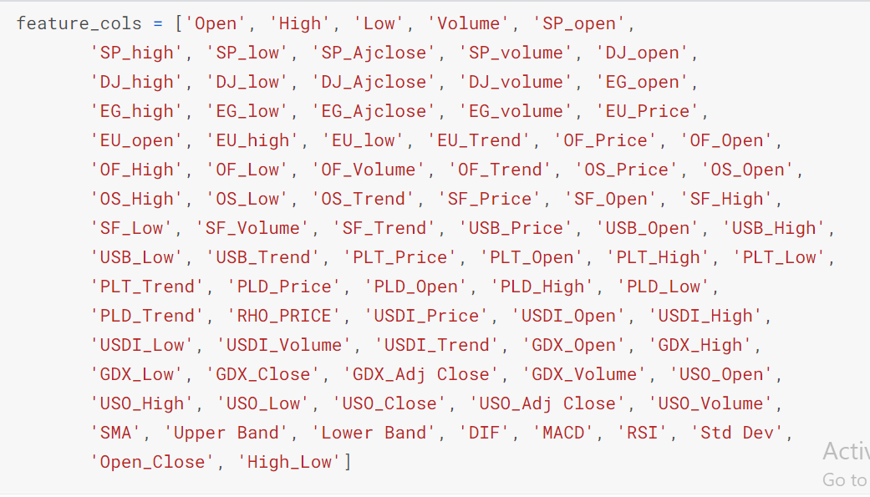
Features added
We have added some other important features like STD, SMA, MACD, RSI etc.
These features effect the overall performance of the model.
We have added 9 more features that made the whole number of features equal to 89.

Slide 12
81 | SMA(Simple moving average ) | SMA is an arithmetic moving average calculated by adding recent prices and then dividing that figure by the number of time periods in the calculation average
82 | Upper band price | Daily Price Range is between the Upper and Lower Price Band. If the previous closing price is 100 and the circuit limit is 10% – the Price Range for the day will be 90 to 110. ... At this price, there are only sellers and no buyers for the stock. If the price reaches 110 – it's called upper circuit
83 | Lower band price | The price range the issuer and underwriter agree upon is referred to as the price band. The bottom band is the lower limit and the top band is known as the upper limit
84 | MACD | Moving average convergence divergence (MACD) is a trend-following momentum indicator that shows the relationship between two moving averages of a security's price.
85 | RSI | The relative strength index (RSI) is a momentum indicator used in technical analysis that measures the magnitude of recent price changes to evaluate overbought or oversold conditions in the price of a stock or other asset.
86 | Std Dev | a measure of how dispersed the data is in relation to the mean.Standard deviation is a statistical measurement in finance.
87 | Open_Close | Difference between open and close
88 | High_Low | Difference between high and low
89 | DIF | Difference feature

Slide 13
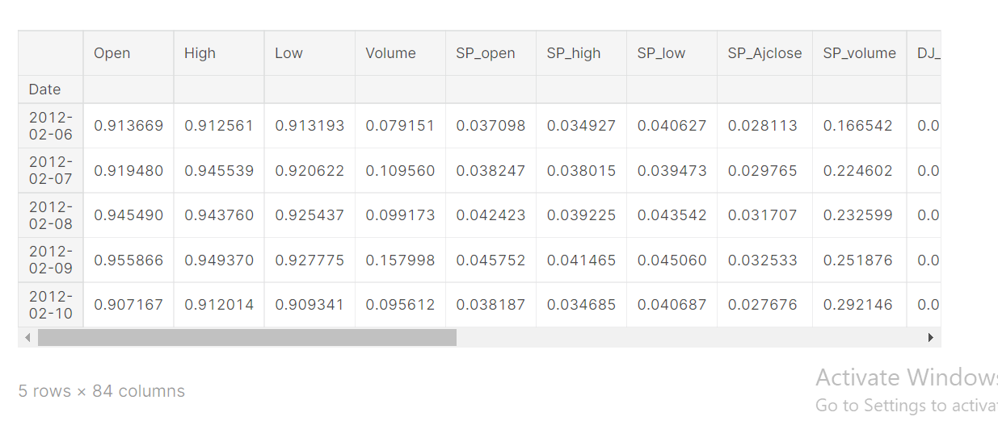
Normalization/Dropping features
The next step we performed was normalization.
We also dropped some unimportant features.
The features count is now 84.

Slide 14
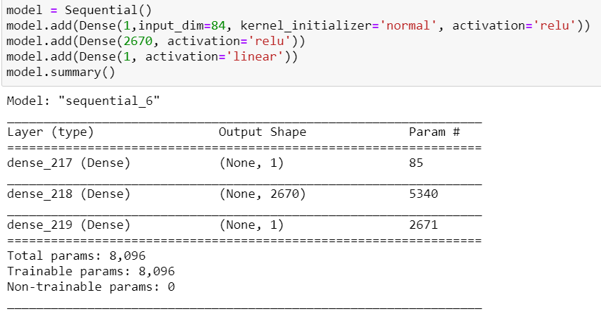
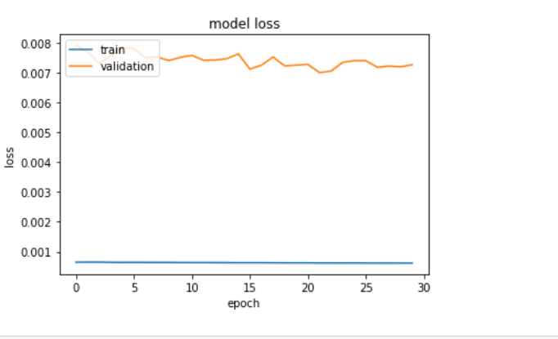
Model
CNN 1D model is used here.
ReLu as Activation function is used in first approach.

Slide 15
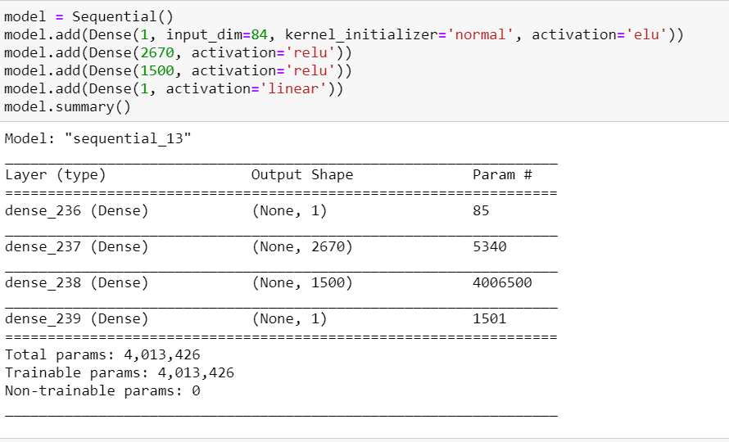
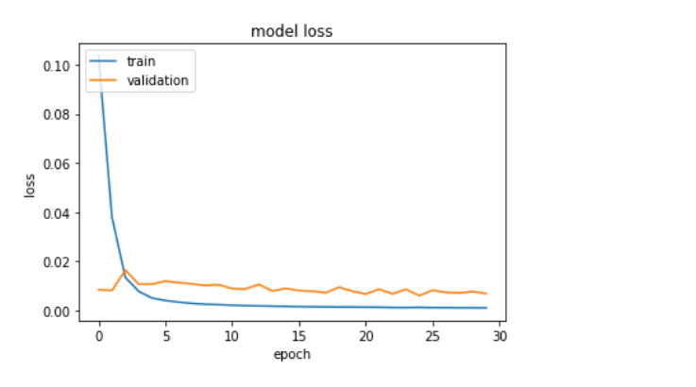
ELU as Activation
In the second approach ELU as activation function.
We added one more hidden layer that increased model performance.

Slide 16
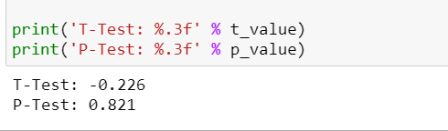
T-Test and P-Test Results

Slide 17
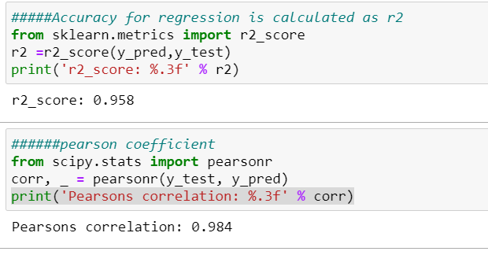
R2 Score and Karl Pearson Corelation

